Slide 1
BuyFy E-Commerce Project
A small initiative by the scholars towards a web-application development
Akshat Singh
Rishabh Kumar Singh
Raghvendra Singh Bhati
Devyanshu Arora

Slide 2
Contents
Project Overview
About BuyFy
Requirements
Functional Modules
GUI Homepage
Admin Dashboard
Why Us?
Field Resources
Target Audience
Test Cases
Workflow
ER-Diagram
Scope Of Enhancement

Slide 3
PROJECT OVERVIEW
Online shopping system
Separate systems for administrator and customers
Administrator can add, delete products and users whereas customers can add and delete the products in their cart and checkout to payment.
Well designed, processed and integrated

Slide 4


About BuyFy
The BuyFy application enable customers to browse through the shops, and a system administrator to approve and reject requests for new shops and maintain lists of shop categories. Also the developer is designing an online shopping site to manage the items in the shop and also help customers to purchase them online without visiting the shop physically.

Slide 5








Requirements
We have developed this web applications using:
Apache Server

Slide 6
Functional Modules for Customer
Registration : If customer wants to buy the product then he/she must be registered, unregistered user can’t add products in their shopping cart.
Login: Customer logins to the system by entering valid user id and password for shopping.
Changes to Orders means the customer after login or registration can make order or cancel order of the product from his/her orders.
Changes to Cart means the customer after login or registration can add or remove a product from the shopping cart.
Payment: We are using PAYTM as our payment gateway. User can also use credit/debit cards for payment as well.
Logout: After ordering or surfing for the product customer can logout also.
Report Generation: After ordering, the user will get invoice of order bill in pdf format and acknowledgement letter to the customer’s Email-address.

Slide 7
Functional Modules for Administrator
Login: Administrator logins to the system by entering valid user id and password for the system.
Changes to products means the administrator can add or delete products.
Changes to Users means the administrator can add or delete its users and their details from the system.
Admin Dashboard: The admin can also access some extra features and functionalities than a normal user through the admin dashboard.

Slide 8
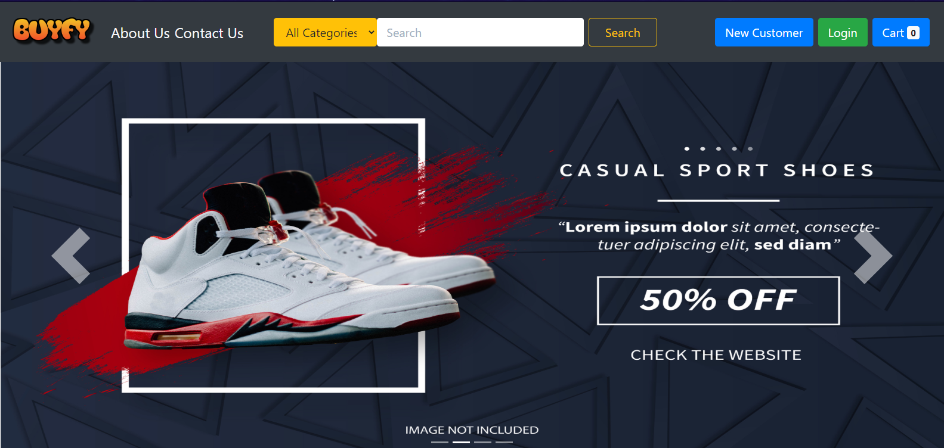
GUI-HOMEPAGE
This is the main homepage of our website. You can register as a new customer or login if already a customer.
This slider provide you with banners of some products.

Slide 9
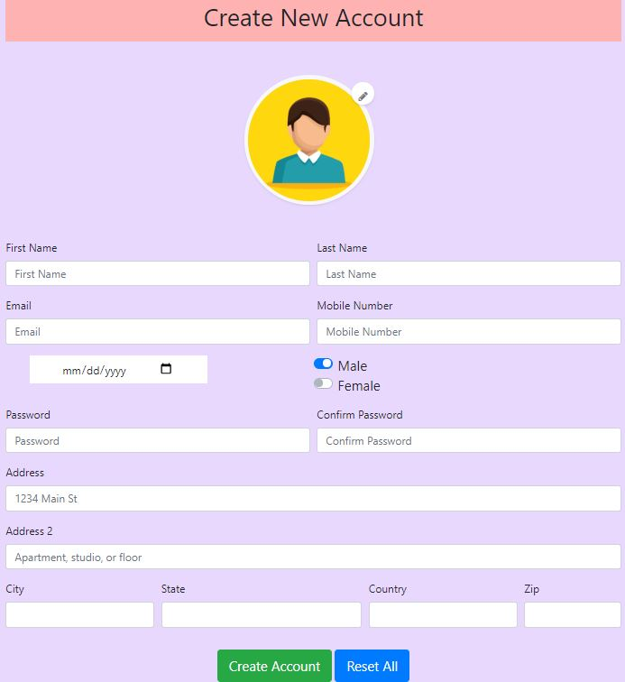
This is the signup page for a new customer.
The customer can upload his/her profile picture and preview from here itself. There is no need to open the picture.
After entering all the details the customer can click on the Create Account button else Reset All to reset the page.

Slide 10
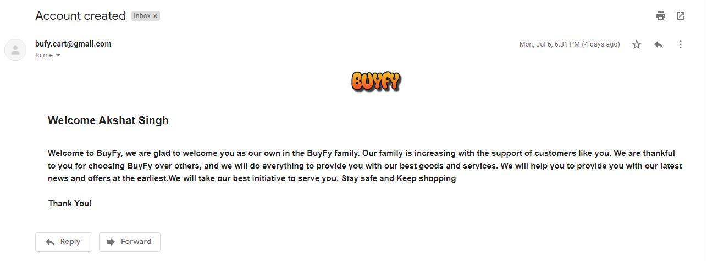
This is the verification mail of account creation. The customer will receive this mail once their account is created. This is an auto-generated mail.

Slide 11
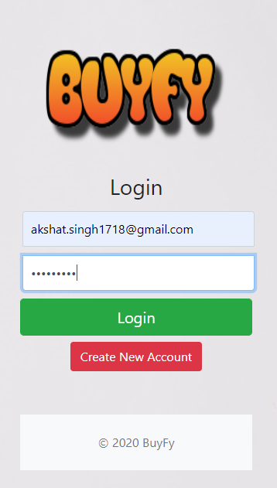
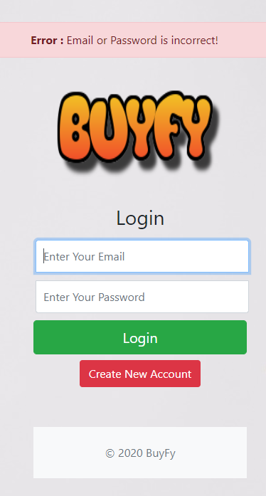
If wrong credentials are entered then the page is reset and the customer has to enter details again.

Slide 12
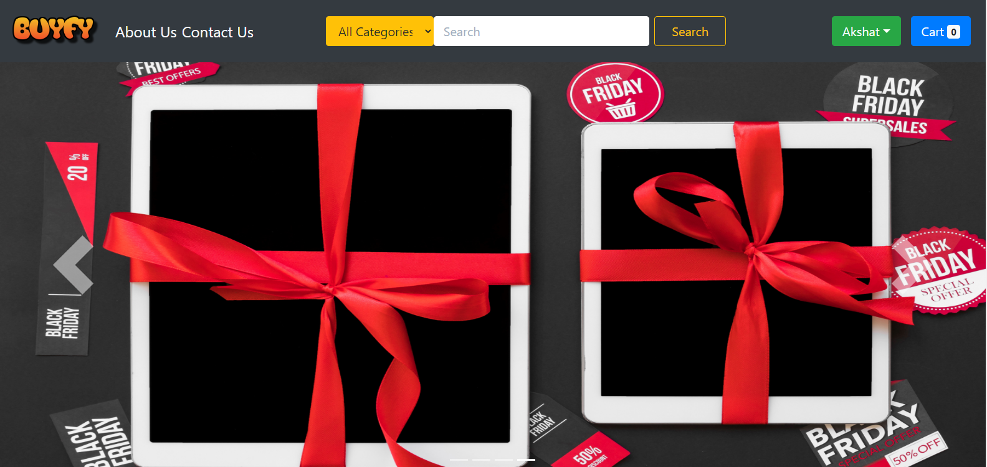
After login the name of the user is displayed.

Slide 13
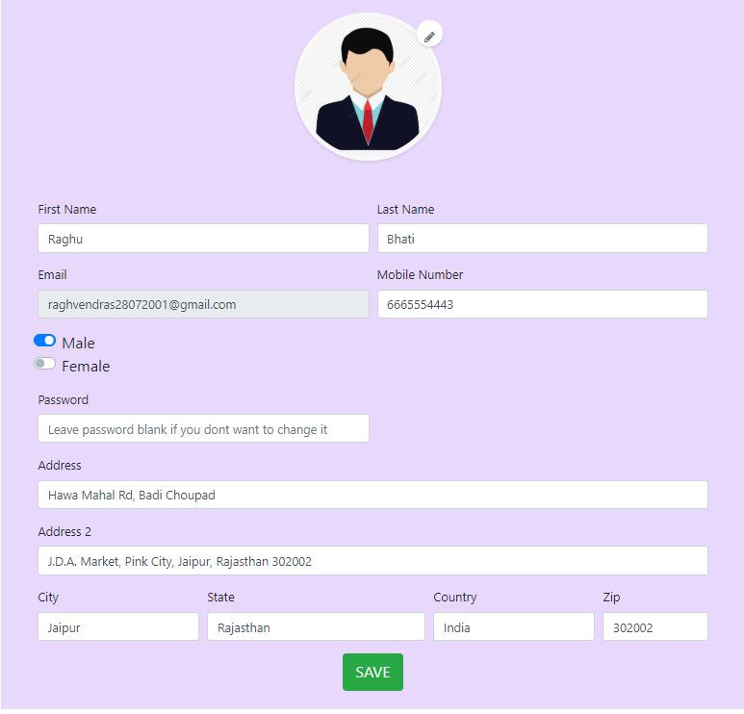
This is the edit profile page. The customer can change or edit their details and profile picture.

Slide 14
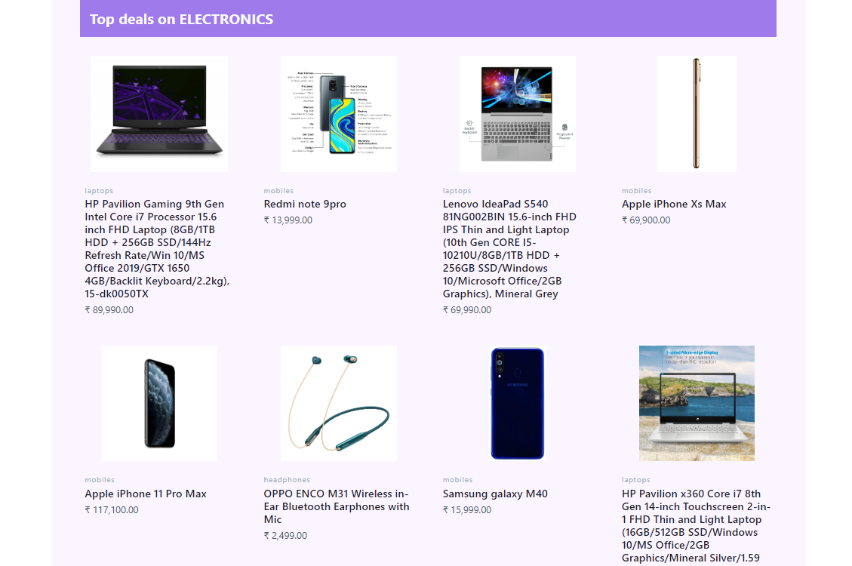
As you scroll down the homepage, you can see products according to the categories like electronics, books, accessories, sports, etc.

Slide 15
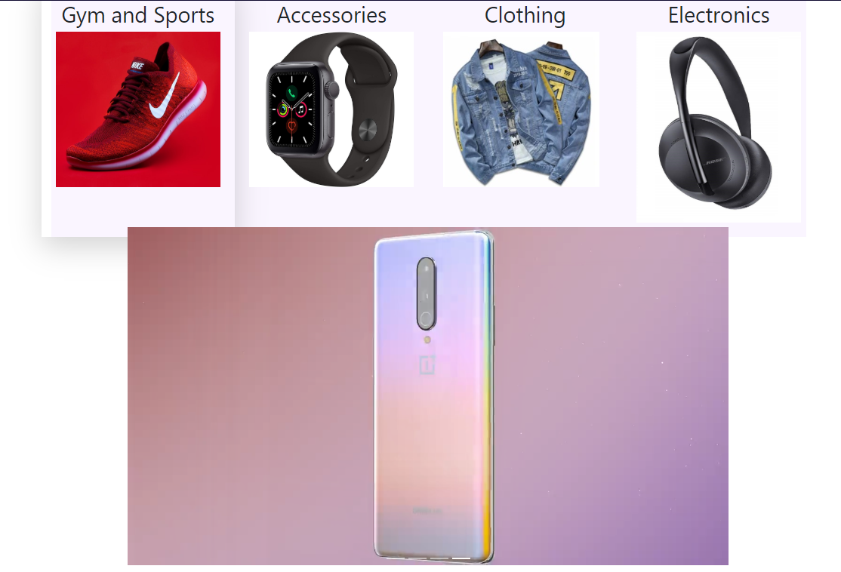
You can also select to access the products via category
This slider will allow you to display some products through videos.

Slide 16
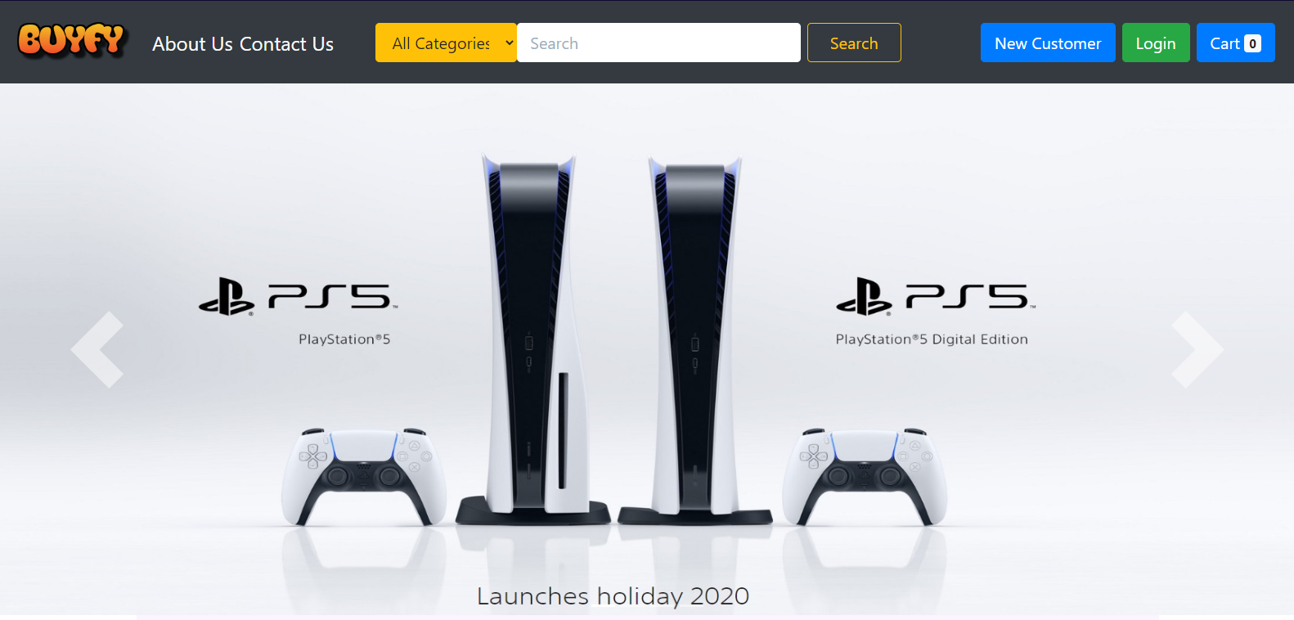
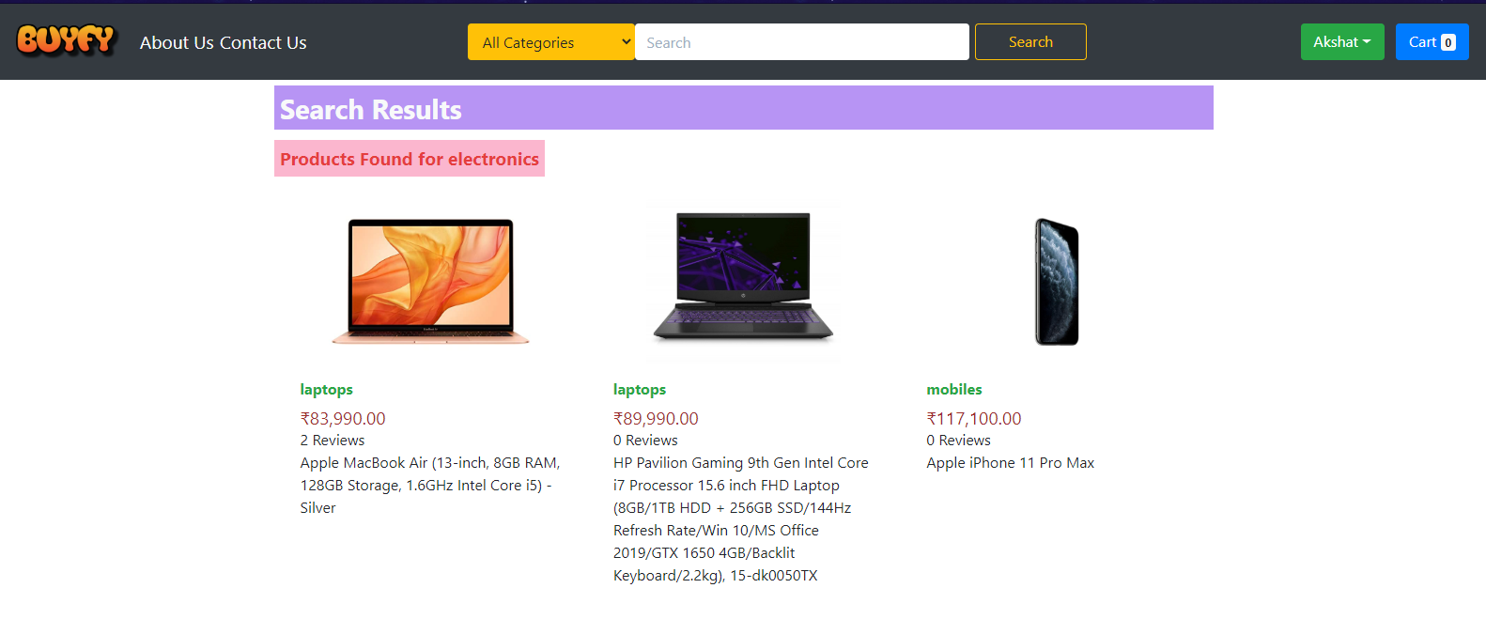
This is a drop-down for category of the products.
This is displaying the products for a particular category.

Slide 17
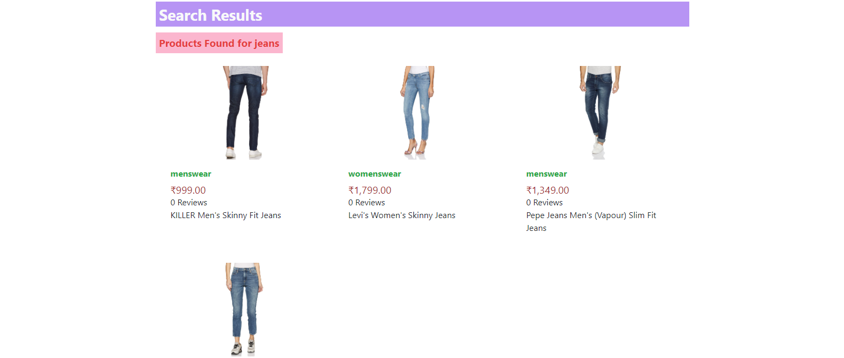
If you are searching a product in a category.
You will be able to see the related products available in the category.

Slide 18
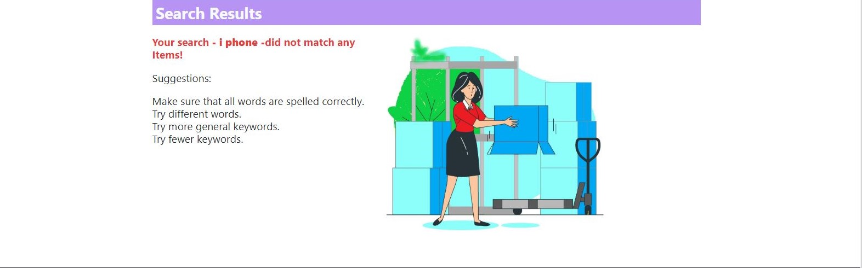
If you are searching for a product in the wrong category.
You will be able to see no products with this image and give some suggestions as shown.

Slide 19
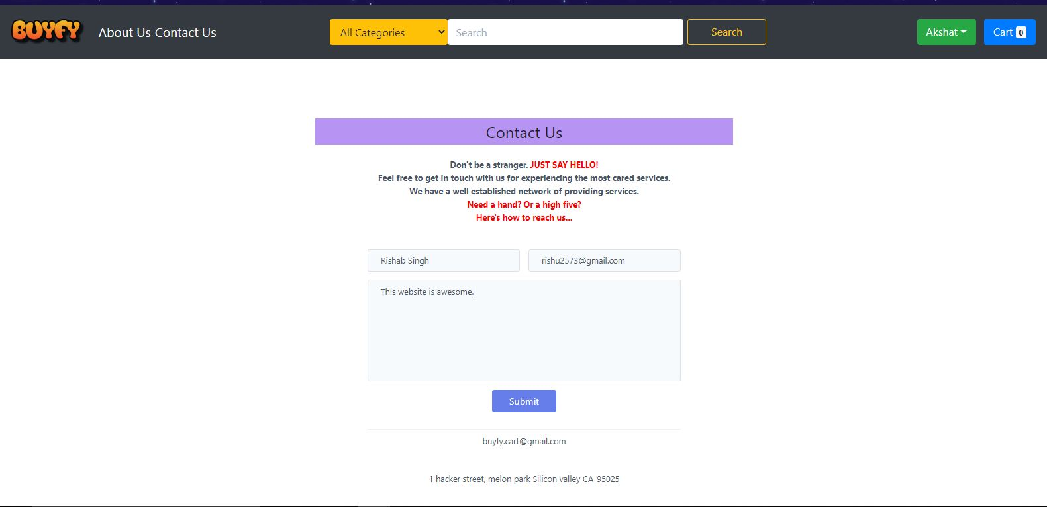
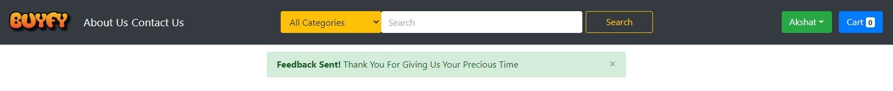
This is the contact us page. You can ask or give suggestions for our website.
You will get a confirmation once your response is saved. The admin can see the response.

Slide 20
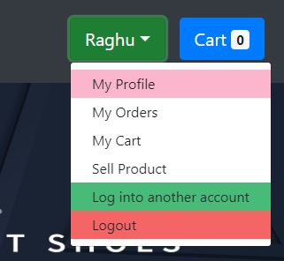
This will show the profile of the customer with the details.
This will show all the orders and their details.
This will show the products in the cart.
The customer can sell their own products by providing the details.

Slide 21
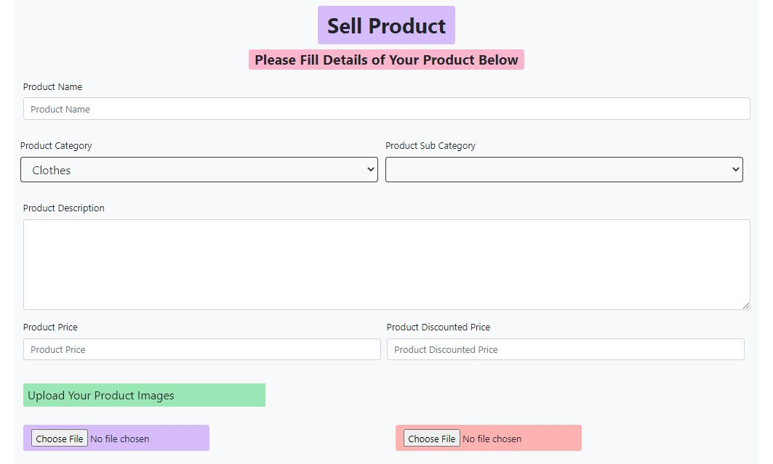
The customer can sell their products with filling their product details and pictures.

Slide 22
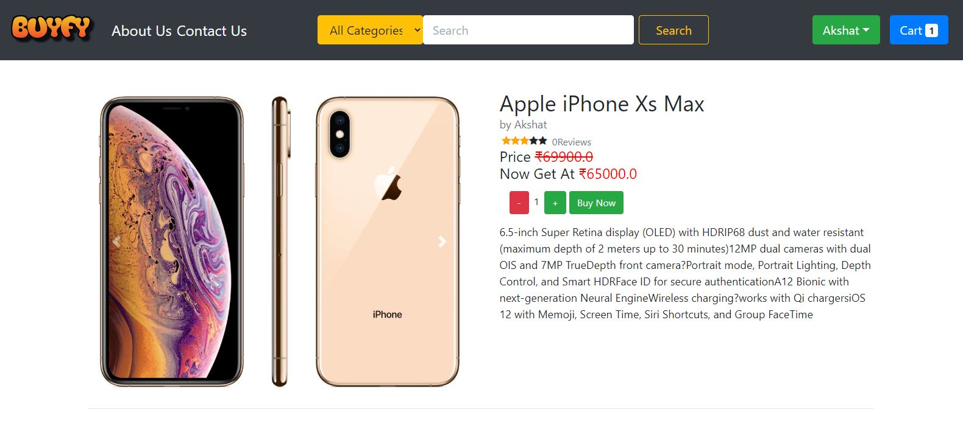
You can see the cart from this. You can also see the number of products in the cart without actually opening the cart.
You must be logged in to add the product in the cart.
This is the description of a particular product with some images.

Slide 23
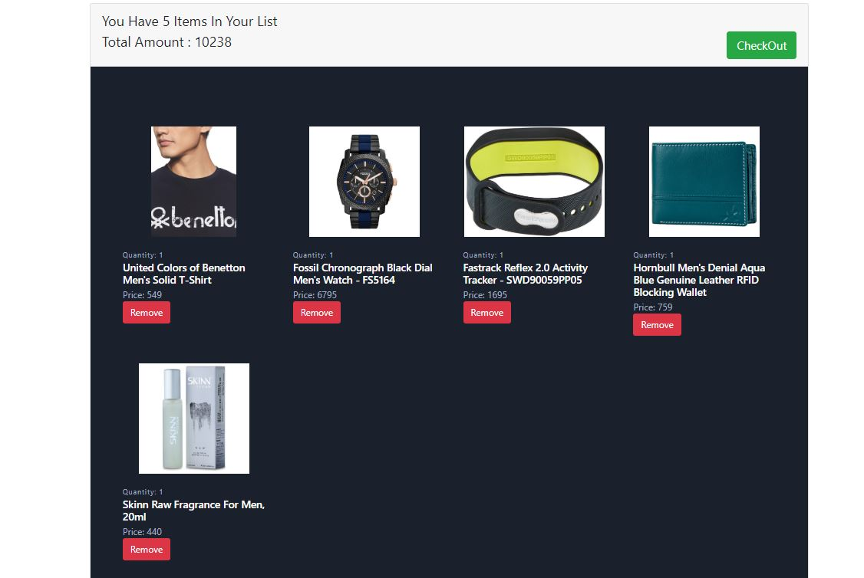
This gives you the quantity of products with the total amount of the products.
This is the cart. You can remove the products if added by mistake or don’t buying that product.

Slide 24
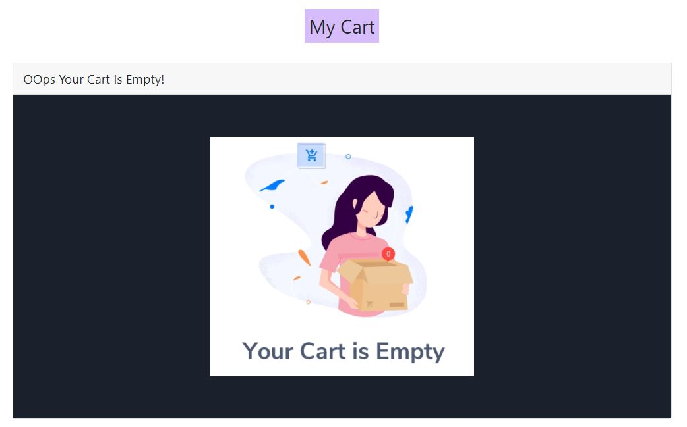
If your cart is empty then you will be able to see this image.

Slide 25
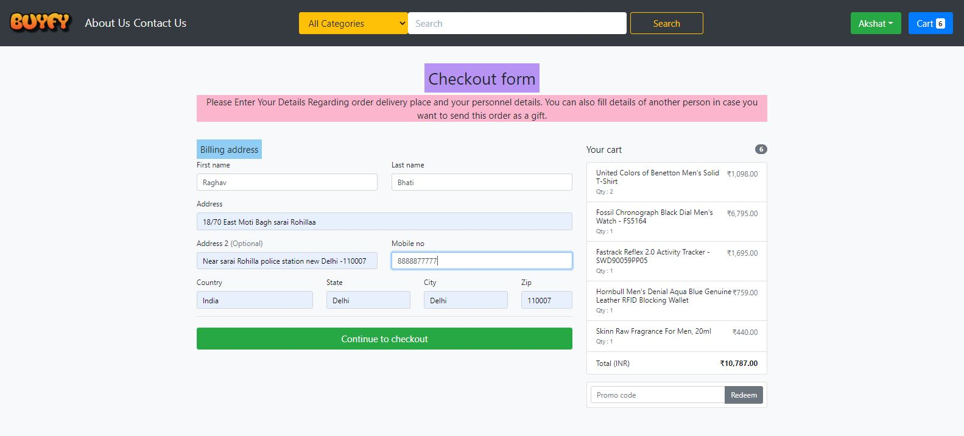
This is the checkout page.
The customer have to provide the details for the delivery.
Here you can see the total number of products checking out with there individual amount and names.

Slide 26
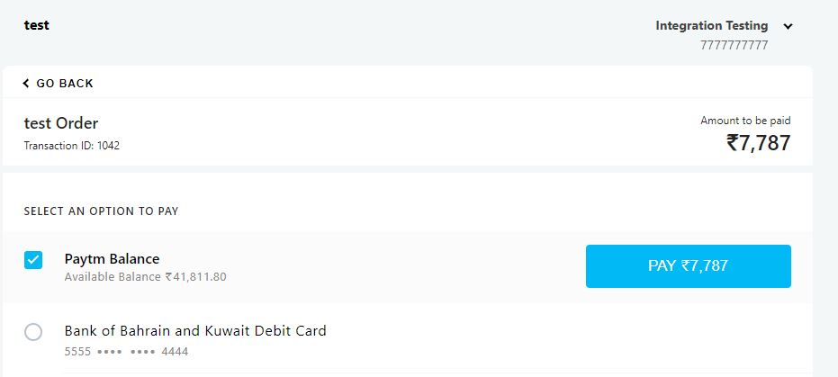
This is the payment page.
Total amount to be paid
Options for payment can be card or PayTm.

Slide 27
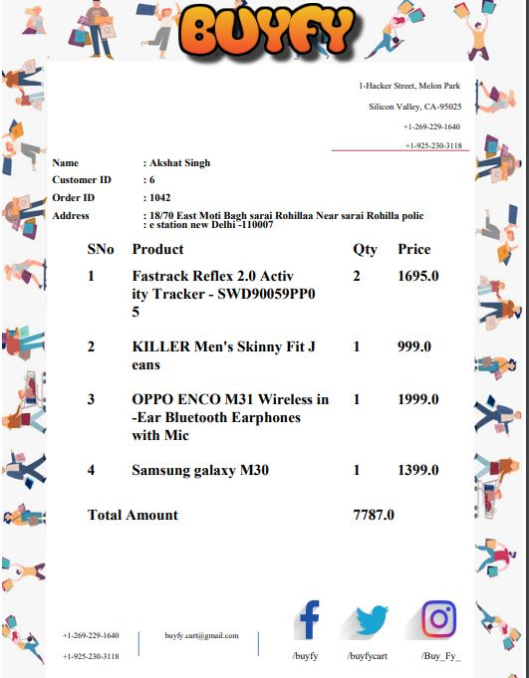
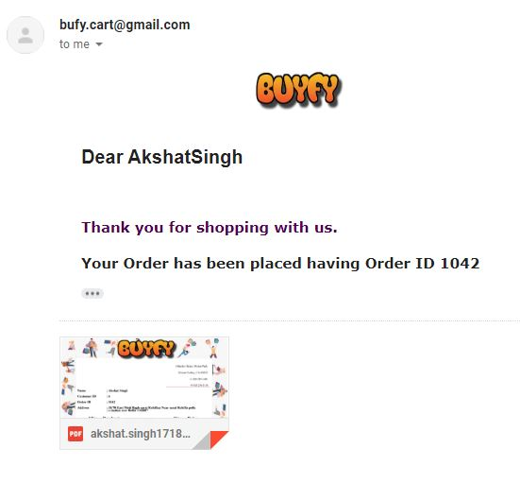
Once the order is placed, the system will send an email to the customer with the details of the order through Gmail.
The bill will look like this
The email will have a pdf attached for the bill.
The bill will consist the product’s details with quantity and amount. At the top it will have the address and at the bottom the bill will have the contact details like phone number, email Id and social linkings.

Slide 28
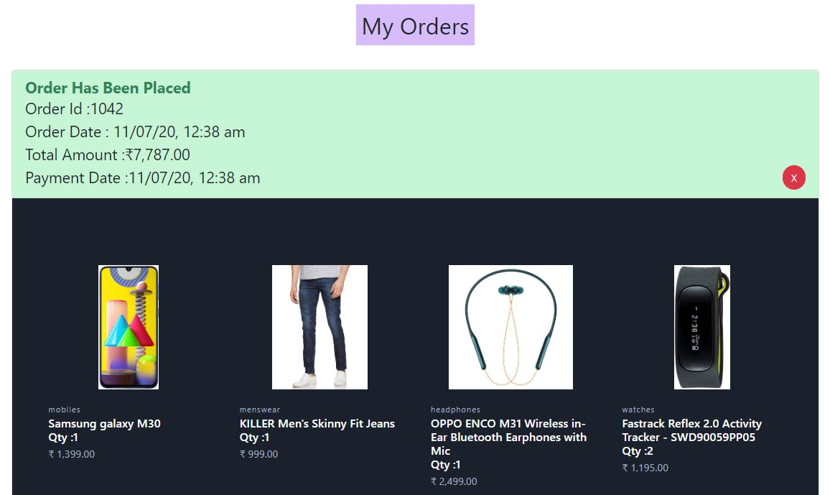
You can see all your orders in My Orders.

Slide 29
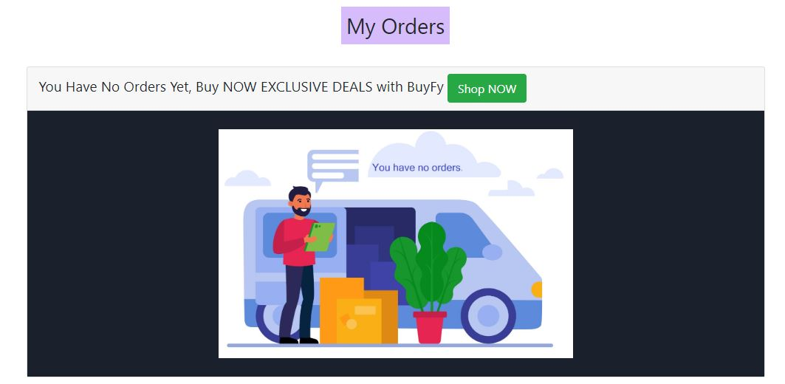
You can redirect to the homepage for shopping as you have no orders.
If the customer has no order placed yet, this will be visible with a picture of no orders.

Slide 30
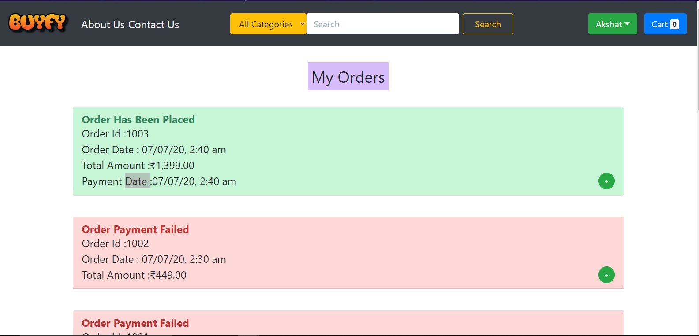
Your order details are displayed here including order ID, date placed and total amount.
You can close the order details to ease the view over your orders.
Red color for indicating order failed and green for order placed successfully.

Slide 31
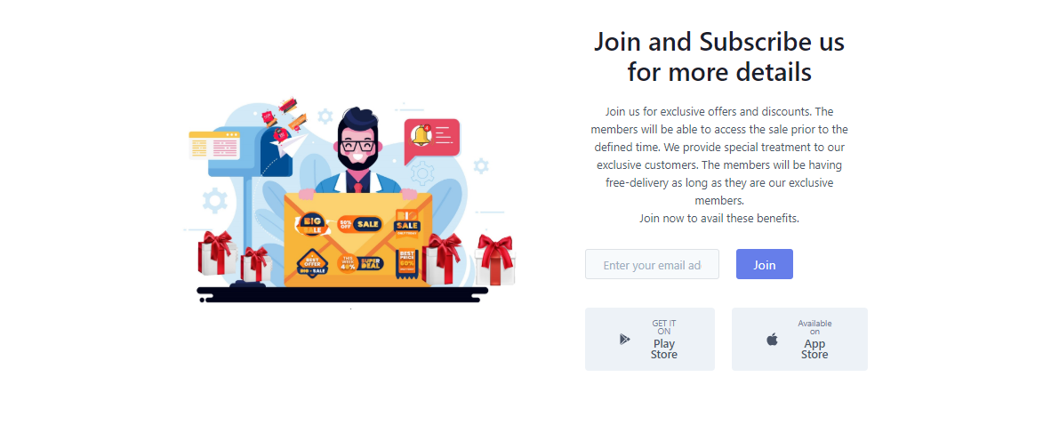
The customer can join and subscribe us for exclusive offers and benefits.
These are the availability of our website on android and IOS through Play Store and App Store respectively.

Slide 32
GUI
Navbars
Dropdown List
Stock Pictures and Videos
Smooth and luxurious
We have done everything for easy access of the application. The GUI is very attractive and have a luxurious look.
We have introduced a number of navigation bars and columns for easy access of the products.
We have introduced many drop-down lists for better segregation of the categories.
We have included high resolution pictures, videos and logos.

Slide 33
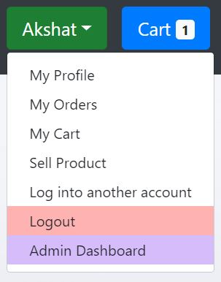
The admin can view his/her own profile, orders, cart, sell their products with some extra functionality than the normal customer
The admin can access the extra functionalities through the Admin Dashboard.

Slide 34
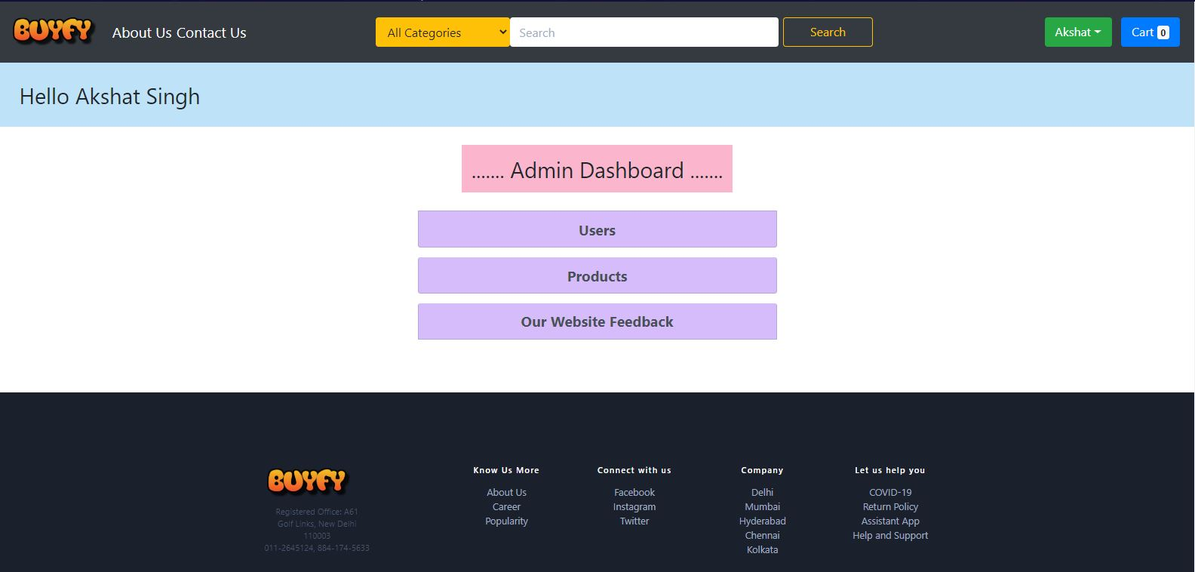
ADMIN DASHBOARD
This will allow the admin to add or remove the users and their details.
This will allow the admin to sell and manage products.
This will allow the admin to see the feedbacks of the customers which they filled at Contact Us page.

Slide 35
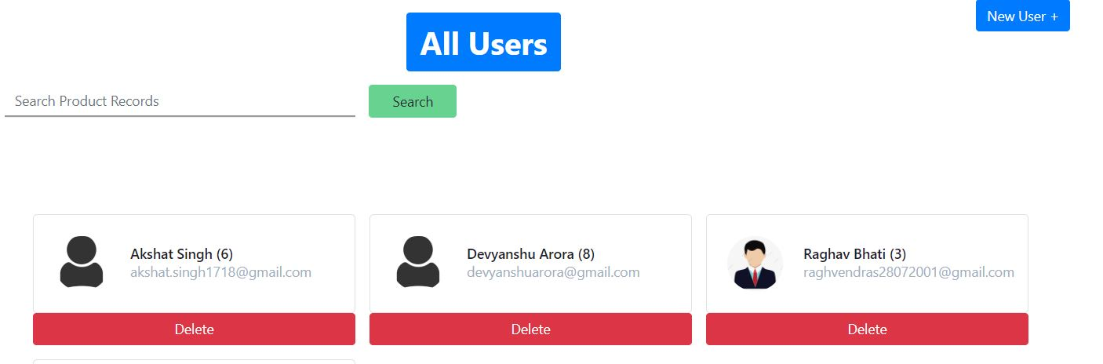
Users can be searched
The admin can create a new user with different types.
The admin can manage the users and their details in their system.

Slide 36
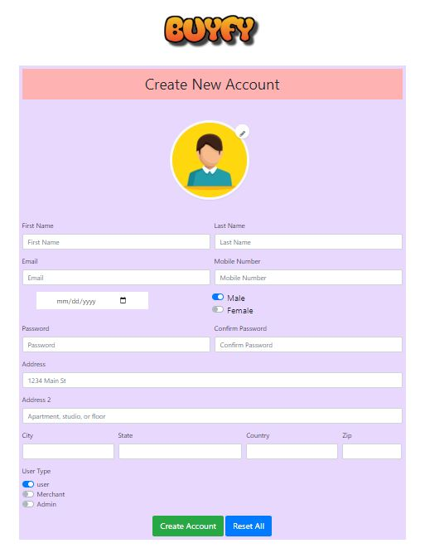
This is the same registration page for the customers but the admin can create types of account like for a user, merchant, or another admin.

Slide 37
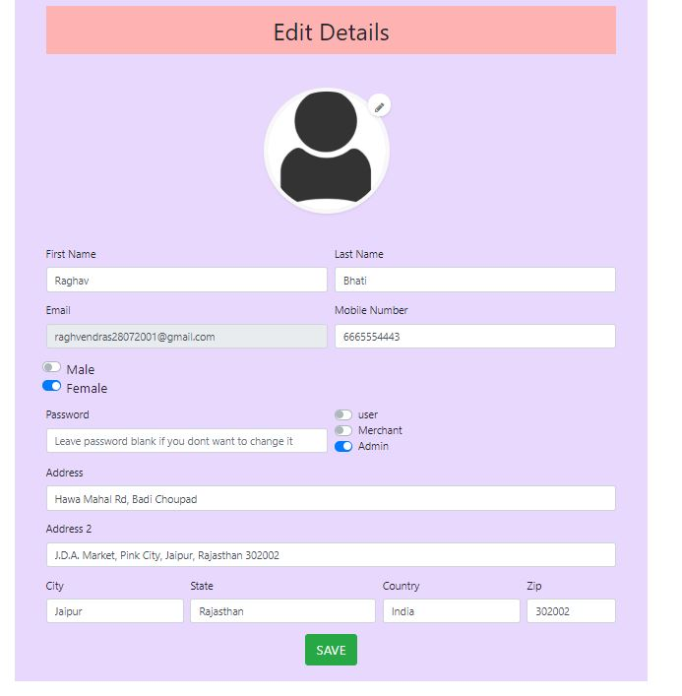
The admin can edit the details of the users. He/she can also change the type of the customer.

Slide 38
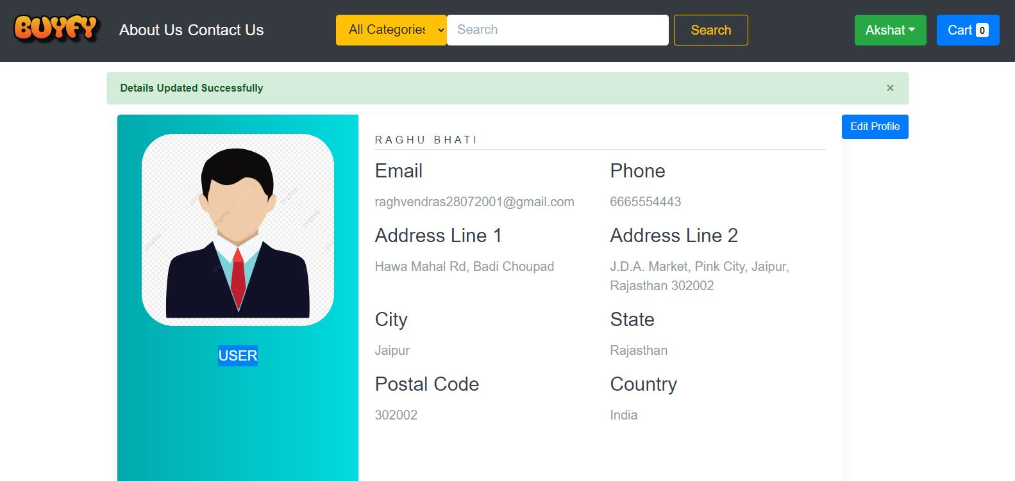
The admin can edit the profile of the user.

Slide 39
Operations Of Admin
Users: This function allows the administrator to delete and manage the users accessing this system.
Orders: This function allows the administrator to delete and manage the orders in this system.
Our Website Feedback: This function allow the administrator to view the feedbacks given by their customer on Contact Us page.

Slide 40
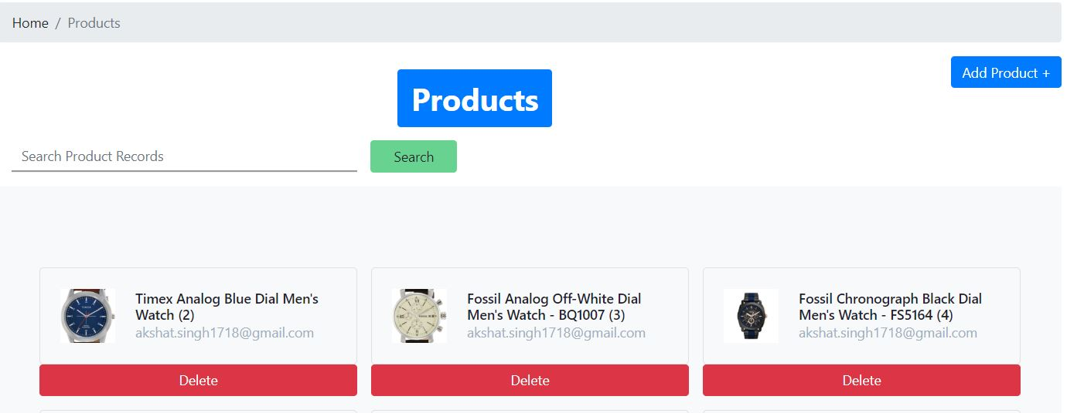
Products can be searched
The admin can add a new product also.
The admin can manage the products.

Slide 41
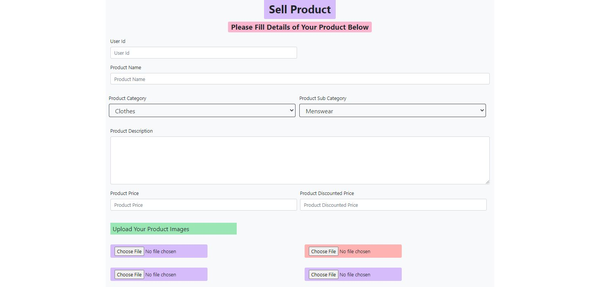
The admin can sell or add a product using the user Id which normal user cannot do.

Slide 42
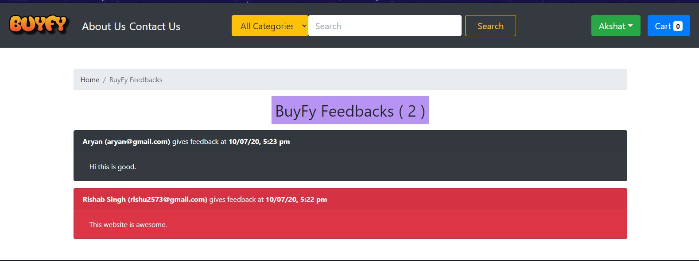
The admin can view all the feedbacks and suggestions given on the Contact Us page.

Slide 43
WHY US?
We provide a variety of products distributed into categories according to their needs for our customers.
Our application is very easy to use and have multiple functions for the customers.
The customers(merchant) can sell their own products on our website.
A Customer can give feedback to our websites also, so we can improve our website in future and remove malicious malpractices.
Our website has very luxurious and user-friendly UI.

Slide 44
Safety At First
We are using AUTH-Token (like csrf verification token) for securing our website. User can make their BuyFy account only from our website and we will provide our AUTH-Token in the current session.
Our CSRF token is 64 characters long and is able to provide a strong authentication and malicious requests are rejected if the token is not correct.

Slide 45
FIELD RESOURCES
UI
35%
Coding
35%
Integration
10%
Testing
10%
Documentation
10%
This chart shows the amount of time we spent on particular fields.

Slide 46
TARGET AUDIENCE
Understanding the Importance of Target Audience
One of the primary concern that online businesses face a lot of traffic on their websites. There is no denying that the latest tools and techniques have helped us drive away traffic from our platforms.
Defining our target audience can assist our business strategies in many ways. It saves up our marketing energy that was previously being utilized to reach a bigger, but less interested audience. As a result, we can generate the same revenue with lesser resources if we know what our target audience is looking for.
2) Know your audience
Audience in the ecommerce industry works differently from that of real world. Merchants don’t interact with customers as they would at a physical shop. Hence, judgment on one’s behavior and personality varies at almost every encounter. It is important that we understand the lifestyle and behavior of people who follow a regular pattern. This removes the need for carrying out basic research as we already know: what, how and when your potential customer want our products.

Slide 47
3) Picture Your Customer
We have an understanding of our ecommerce target market. This step has been carried out by making an individual profile for every user that visits our online store. Once determined who we have to focus on, our marketing decisions will become much easier. We are able to selectively target a group of similar customer profiles.
324019024
Surveys and Customer Feedbacks
It has become a common practice to record customer feedback right after completing business with them. Data generated from surveys and customer feedback can use to display where our ecommerce business stands and which segment can be improved. In addition, due to regular communication with customers, we also provide them to write reviews of our product or service on public rating forums which will be useful for others and us as well.

Slide 48
TEST CASES
Our team has done a remarkable and full fledged testing of our project. We have included almost all types of scenarios and cases we have in our project. We have included the list of test cases we have done for the project and all are functionalities are working at its best.
We have divided the cases in three parts:
General Cases
User Registration
Product Management

Slide 49
TEST CASES General Cases
Verification
Verify that the user is able to navigate through all the products across different categories.
Verify that all the links and banners are redirecting to correct product/category pages and none of the links are broken.
Verify that the company logo is clearly visible.
Verify that all the text – product, category name, price, and product description are displayed correctly.
Verify that all the images – product and banner are clearly visible.
Verify that category pages have a relevant product listed specific to the category.
Verify that the correct count of total products is listed on the checkout page.

Slide 50
Search
Verify that on searching all the product satisfying the search criteria are visible on the search result page.
Verify the more relevant product for the search item is displayed on the top for a particular search item..
Filtering
Verify that filtering functionality correctly filters products based on the filter applied.
Verify that filtering works correctly on category pages.
Verify that filtering works correctly on the search result page.

Slide 51
TEST CASES User Registration
Verify that all the specified fields are present on the registration page.
Verify that the required/mandatory fields are given by the users.
Verify that for better user interface dropdowns, radio buttons and checkboxes etc. fields are displayed wherever possible instead of just textboxes.
Verify the page has both submit and reset buttons at the end.
Verify that clicking submits button after entering all the required fields, submits the data to the server.
Verify that clicking reset button after entering all the required fields, reset all the fields.
Verify that whenever possible validation should take place at client side.

Slide 52
Verify that not filling the optional fields and clicking the submit button will still send data to the server.
Check validation on the date and email fields (only valid dates and valid email Id) should be allowed.
Characters and special symbols are not allowed in numeric input boxes.
Verify that user cannot signup with same email for different BuyFy account.

Slide 53
TEST CASES Product Management
Verify that the user can add to cart one or more products.
Verify that the user can buy products added to the cart after signing in to the application.
Verify that the user can successfully buy more than one product that was added to his/her cart.
Verify that the option of payment is working fine.
Verify that the payment gateway is working fine.

Slide 54
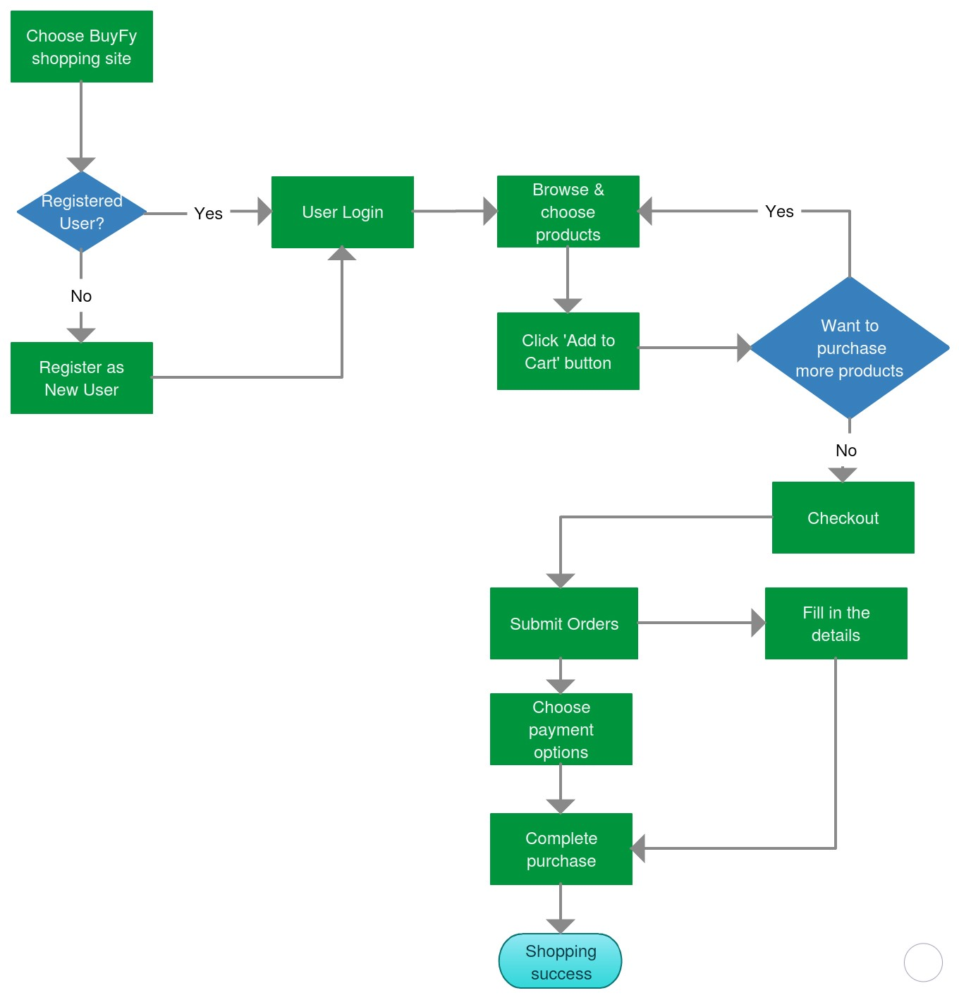
WORKFLOW

Slide 55
WORKFLOW
WORKFLOW
Homepage is available to every user. If a user wants to buy a product then he/she has to first register at our site by filling the credentials. The user will get an email for the same.
Once user is registered, add to cart functionality has been opened. user can add, remove, update the cart.
User can login with the same credentials anytime.
When the buyer press the checkout page the user is redirected to a page displaying the order details.
The buyer can later check his/her order in the My Orders page.

Slide 56
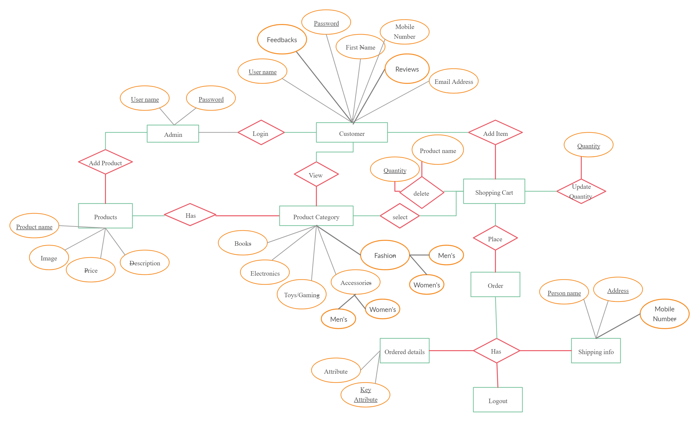
ER-DIAGRAM

Slide 57
SCOPE OF ENHANCEMENT
Return functionality of the products will be added on upcoming enhancements.
Function of cancelling the orders.
Function of reordering of orders which were cancelled.
Function of applying coupons and promocodes for discount.
Function of automated chat window if the user has a query to ask.

